Slide 1
Specification of Response
Decision tree classification of keratoconus. Classification attributes (circles) are labeled as double-indexed Zernike polynomial coefficients. The split criteria values label the branches of the decision tree in units of micrometers. Terminal nodes of the tree (boxes) are labeled with class assignments (Y=keratoconus, N=normal) and the number of records assigned to this class (correct / incorrect).

Slide 2
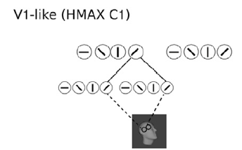
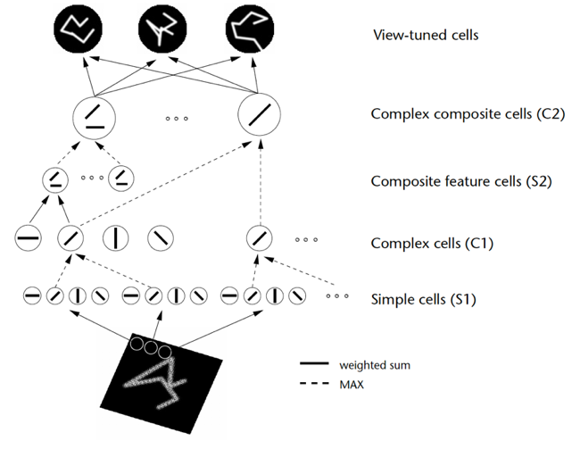
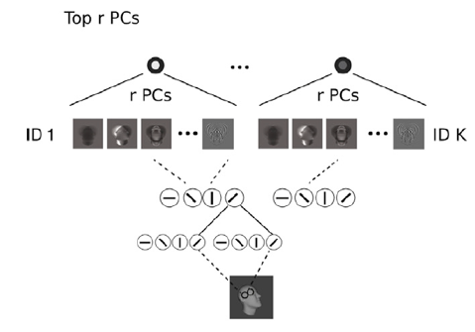
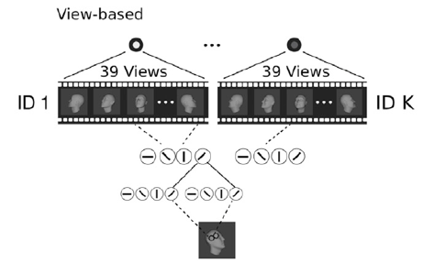
Design of Model Architecture
Sketch of the HMAX model

Slide 3
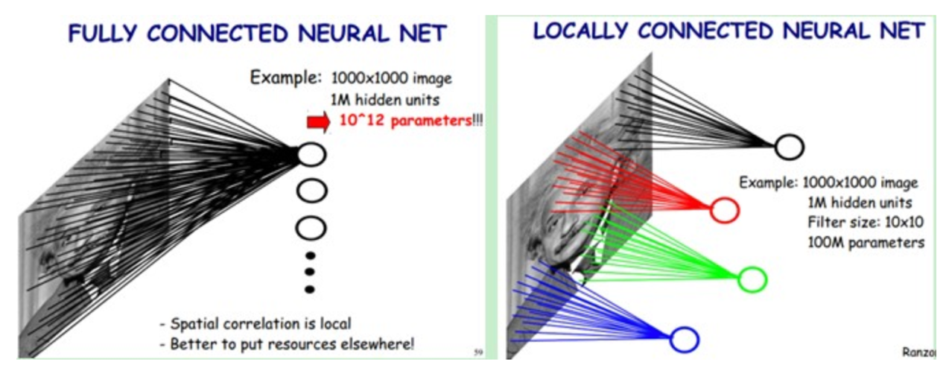
Design of Model Architecture

